Slide 1
CIND119 Presentation Churn Dataset
Group Name: Group_DJ0_ 1
Amarpreet Kaur, amarpreet.kaur@torontomu.ca Eric Ding, pai.ding@torontomu.ca Raymond Chan, r.chan@torontomu.ca
Notes:
Title slide

Slide 2
Executive Summary
Problem: The telecom company wants to predict which customers will churn in the near future.
Solution : Characterizing customers using two Predictive Models (Decision Tree & Naïve Bayes) to predict which customer may leave.
Tools used: Python and SAS
Notes:
Presenter: R

Slide 3
Executive Summary
Conclusion: Decision Tree model with feature selection provides best prediction accuracy (Model accuracy 92.32%);
The most important predictors of customer churn are (based on both DT / NB model):
Day Mins: The number of minutes the customer used the service during daytime
CustServ Calls: The number of calls to customer support service
Int'l Plan: whether the customer has international calling plan
Notes:
Presenter: R

Slide 4
Workload Distribution
Member Name | List of Tasks Performed
Amarpreet | Data Preparation: Analyze the distribution of numeric attributes (normal or other); Plot histograms; handle missing values or transform any attributes; Predictive Modelling: Decision Tree & Naïve Bayes models in Python Conclusion and Recommendation: (Shared Equally - We reached conclusion & wrote recommendation together) Presentation: Predictive Modeling - Python
Eric Ding | Data Preparation: Correlated attributes; Elimination of attributes (subjective decision or an objective decision) Predictive Modelling: Decision Tree & Naïve Bayes models in SAS Conclusion and Recommendation: (Shared Equally - We reached conclusion & wrote recommendation together) Presentation: Predictive Modeling- SAS; Conclusion & Backup Slides
Raymond Chan | Data Preparation: attribute type; descriptive analysis Predictive Modelling: Decision Tree & Naïve Bayes models in Python Conclusion and Recommendation: (Shared Equally - We reached conclusion & wrote recommendation together) Presentation: Introduction & Data Preparation
Notes:
Presenter: R

Slide 5
Data Preparation Step 1 : Look at the attribute type
Column | Explanation | Variable Type | Data Type
State | Customer’s state | Categorical (Nominal) | object
Account Length | Integer number showing the duration of activity for customer account | Quantitative (Continuous) | int64
Area Code | Area code of customer | Categorical (Nominal) | int64
Phone Number | Phone number of customer | Categorical (Nominal) | object
Inter Plan | Binary indicator showing whether the customer has international calling plan | Categorical/ Binary (yes, no) | object
VoiceMail Plan | Indicator of voice mail plan | Categorical/ Binary (yes, no) | object
No of Vmail Mesgs | The number of voicemail messages | Quantitative (Discrete) | int64
Total Day Min | The number of minutes the customer used the service during day time | Quantitative (Continuous) | float64
Total Day calls | Discrete attribute indicating the total number of calls during day time | Quantitative (Discrete) | int64
Total Day Charge | Charges for using the service during day time | Quantitative (Continuous) | float64
Notes:
Presenter: R

Slide 6
Data Preparation Step 1 : Look at the attribute type
Column | Explanation | Variable Type | Data Type
Total Evening Min | The number of minutes the customer used the service during evening time | Quantitative (Continuous) | float64
Total Evening Calls | The number of calls during evening time | Quantitative (Discrete) | int64
Total Evening Charge | Charges for using the service during evening time | Quantitative (Continuous) | float64
Total Night Minutes | Number of minutes the customer used the service during night time | Quantitative (Continuous) | float64
Total Night Calls | The number of calls during night time | Quantitative (Discrete) | int64
Total Night Charge | Charges for using the service during night time | Quantitative (Continuous) | float64
Total Int Min | Number of minutes the customer used the service to make international calls | Quantitative (Continuous) | float64
Total Int Calls | The number of international calls | Quantitative (Discrete) | int64
Total Int Charge | Charges for international calls | Quantitative (Continuous) | float64
No of Calls Customer Service | The number of calls to customer support service | Quantitative (Discrete) | int64
Churn | Class attribute with binary values (True for churn and False for not churn) | Categorical/ Binary (TRUE, FALSE) | object
Notes:
Presenter: R

Slide 7
Data Preparation Step 2 : Stat summary of numerical columns
index | count | mean | std | min | 25% | 50% | 75% | max
Account Length | 3333.0 | 101.0648065 | 39.82210593 | 1.00 | 74.00 | 101.00 | 127.00 | 243.00
No of Vmail Mesgs | 3333.0 | 8.099009901 | 13.68836537 | 0.00 | 0.00 | 0.00 | 20.00 | 51.00
Total Day Min | 3333.0 | 179.7750975 | 54.4673892 | 0.00 | 143.70 | 179.40 | 216.40 | 350.80
Total Day calls | 3333.0 | 100.4356436 | 20.06908421 | 0.00 | 87.00 | 101.00 | 114.00 | 165.00
Total Day Charge | 3333.0 | 30.56230723 | 9.259434554 | 0.00 | 24.43 | 30.50 | 36.79 | 59.64
Total Evening Min | 3333.0 | 200.980348 | 50.71384443 | 0.00 | 166.60 | 201.40 | 235.30 | 363.70
Total Evening Calls | 3333.0 | 100.1143114 | 19.92262529 | 0.00 | 87.00 | 100.00 | 114.00 | 170.00
Total Evening Charge | 3333.0 | 17.08354035 | 4.310667643 | 0.00 | 14.16 | 17.12 | 20.00 | 30.91
Total Night Minutes | 3333.0 | 200.8720372 | 50.57384701 | 23.20 | 167.00 | 201.20 | 235.30 | 395.00
Total Night Calls | 3333.0 | 100.1077108 | 19.56860935 | 33.00 | 87.00 | 100.00 | 113.00 | 175.00
Total Night Charge | 3333.0 | 9.039324932 | 2.275872838 | 1.04 | 7.52 | 9.05 | 10.59 | 17.77
Total Int Min | 3333.0 | 10.23729373 | 2.791839548 | 0.00 | 8.50 | 10.30 | 12.10 | 20.00
Total Int Calls | 3333.0 | 4.479447945 | 2.461214271 | 0.00 | 3.00 | 4.00 | 6.00 | 20.00
Total Int Charge | 3333.0 | 2.764581458 | 0.753772613 | 0.00 | 2.30 | 2.78 | 3.27 | 5.40
No of Calls Customer Service | 3333.0 | 1.562856286 | 1.315491045 | 0.00 | 1.00 | 1.00 | 2.00 | 9.00
Notes:
Presenter: R

Slide 8
Data Preparation Step 3 : Outliers & Missing Values
No Missing Values detected
State 0
Account Length 0
Area Code 0
Phone Number 0
Inter Plan 0
VoiceMail Plan 0
No of Vmail Mesgs 0
Total Day Min 0
Total Day calls 0
Total Day Charge 0
Total Evening Min 0
Total Evening Calls 0
Total Evening Charge 0
Total Night Minutes 0
Total Night Calls 0
Total Night Charge 0
Total Int Min 0
Total Int Calls 0
Total Int Charge 0
No of Calls Customer Service 0
Churn 0
Notes:
Presenter: R

Slide 9
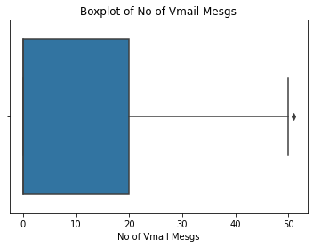
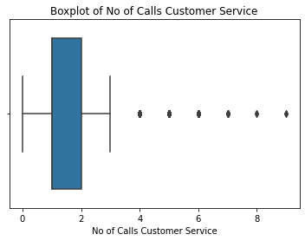
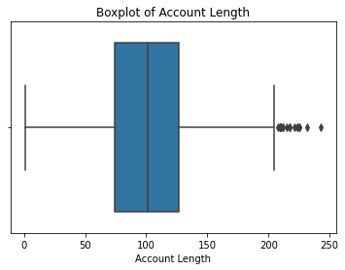
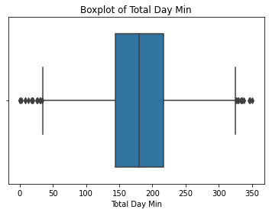
Data Preparation Step 3 : Outliers & Missing Values
We take the data as they are
Notes:
Presenter: R

Slide 10
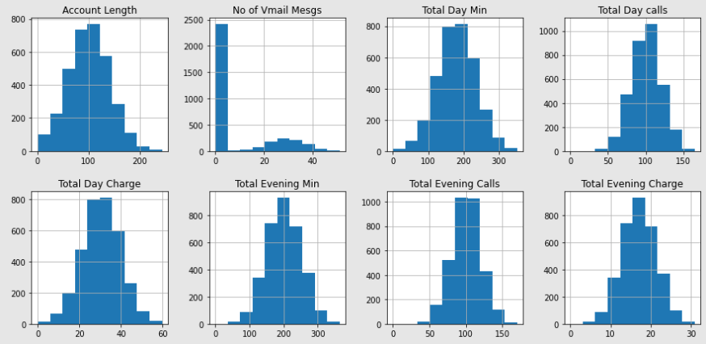
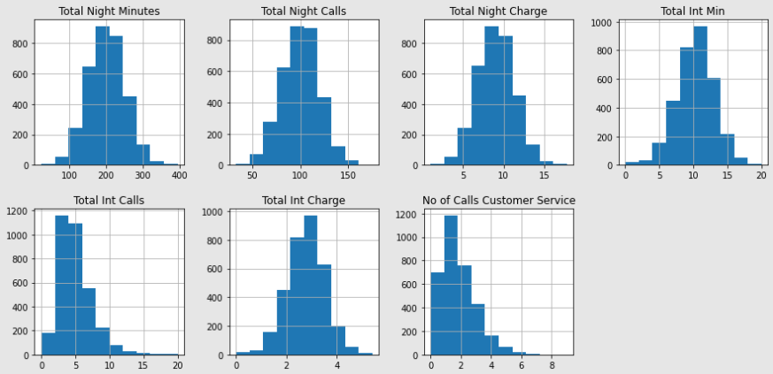
Data Preparation Step 4: Distribution Visualization
Vmail Mesgs has a different dist
No of Customer Service Calls has a skewed Dist
Notes:
Presenter: A

Slide 11
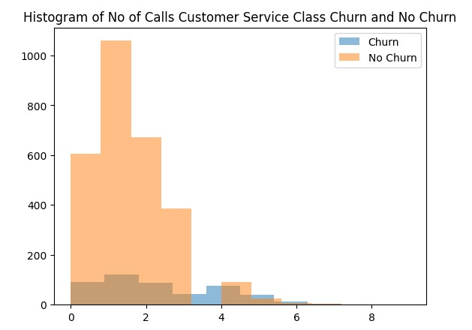
Data Preparation Step 4: Distribution Visualization
Service Calls seems relevant (fatter tail on the right)
Notes:
Presenter: A

Slide 12
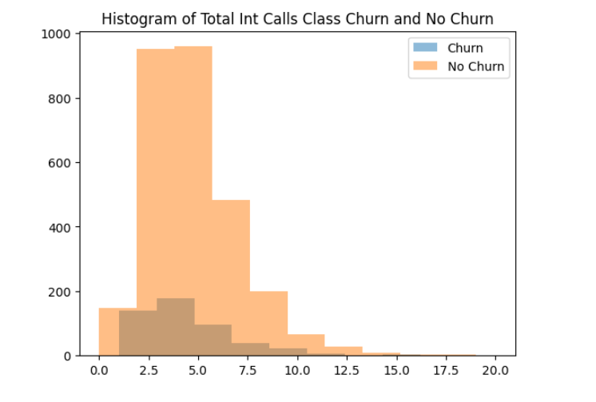
Data Preparation Step 4: Distribution Visualization
Total Int Calls seems not very relevant
Notes:
Presenter: A

Slide 13
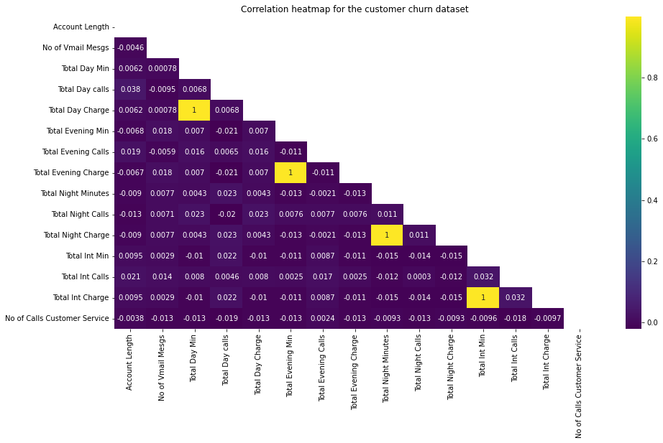
Data Preparation Step 5: Check attribute correlation
Four pairs of highly correlated attributes:
Total Day Charge – Total Day Min,
Total Evening Charge – Total Evening Min,
Total Night Charge – Total Night Minutes,
Total Intl Charge - Total Int Min.
Notes:
Presenter: A

Slide 14
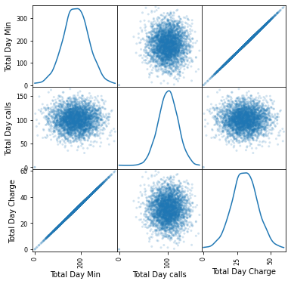
Data Preparation Step 5: Check attribute correlation
Note: Day calls & Day mins are not correlated
Notes:
Presenter: A

Slide 15
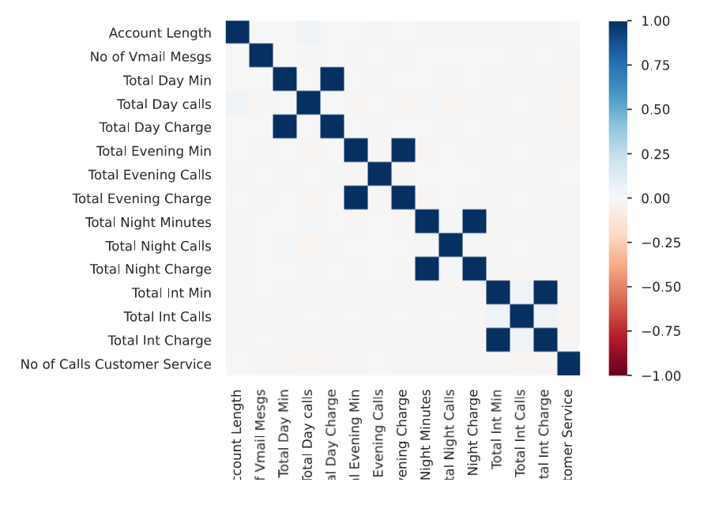
Data Preparation Step 5: Check attribute correlation
Examine Correlation Matrix – Pearson r
Four pairs of highly correlated attributes:
Total Day Charge – Total Day Min,
Total Evening Charge – Total Evening Min,
Total Night Charge – Total Night Minutes,
Total Intl Charge - Total Int Min.
Notes:
If there is anything else to report that didn’t fit on the previous slide then use this one, any sort of visualization or creativity, etc.

Slide 16
Data Preparation Step 6: Attribute Selection (for Comparison)
Subjective judgement:
Drop State, Area Code, Phone number from the dataset due to irrelevancy
Objective judgement:
Out of the 4 pairs of highly correlated attributes, we keep the Mins set and drop the Charges set
Drop Phone number & State due to high cardinality
After the removal, there is 13 (predictors) + 1 (class var) left.
Notes:
Presenter: A

Slide 17
Predictive Modeling - Python
Evaluation method:
train-test set split; 70/30 split
Results (best model = Baseline DT)
Model | Accuracy | Precision of predicting Not Churn | Precision of predicting Churn
Baseline decision tree | 93% [Best] | 94% [Best] | 83% [Best]
Baseline Naïve Bayes | 82% | 90% | 42%
Decision tree on selected features | 90% | 92% | 71%
Naïve Bayes on selected features | 51% | 92% | 20%
Notes:
Presenter: E
We care about “Churn=True” cases more / Goal is to maximize precision on predicting churn

Slide 18
Predictive Modeling - SAS
Evaluation method:
train-test set split; 70/30 split
Results (best model = Selected DT)
Model | Accuracy | Precision of predicting Not Churn | Precision of predicting Churn
Baseline decision tree | 92.21% | 94.92% | 82.61%
Baseline Naïve Bayes | 78.40% | 95.67% | 79.09%
Decision tree on selected features | 92.32% [Best] | 95.24% | 83.44% [Best]
Naïve Bayes on selected features | 84.79% | 93.60% | 64.39%
We care about “Churn=True” precision more
Notes:
Presenter: E
We care about “Churn=True” cases more / Goal is to maximize precision on predicting churn

Slide 19
Confusion Matrix - DT Model
Without Selection With Selection
(Both without Pruning)
Confusion Matrices
 | Actual | Predicted |  | Error Rate
 |  | False. | True.
Training | False. | 2013 | 1 | 0.0005
 | True. | 41 | 302 | 0.1195
Validation | False. | 803 | 33 | 0.0395
 | True. | 43 | 97 | 0.3071
Confusion Matrices
 | Actual | Predicted |  | Error Rate
 |  | False. | True.
Training | False. | 2014 | 0 | 0.0000
 | True. | 40 | 303 | 0.1166
Validation | False. | 801 | 35 | 0.0419
 | True. | 40 | 100 | 0.2857
We also care about “Predicted – F / Actual – T” cases (False negative cases)
Notes:
Presenter: A

Slide 20
Confusion Matrix - NB Model
Without Selection With Selection
Confusion Matrix
 | predictedchurn
Churn? | False. | True. | Total
False. | 2231 | 619 | 2850
 | 66.94 | 18.57 | 85.51
True. | 101 | 382 | 483
 | 3.03 | 11.46 | 14.49
Total | 2332 | 1001 | 3333
 | 69.97 | 30.03 | 100
Confusion Matrix
 | predictedchurn
Churn? | False. | True. | Total
False. | 2515 | 335 | 2850
 | 75.46 | 10.05 | 85.51
True. | 172 | 311 | 483
 | 5.16 | 9.33 | 14.49
Total | 2687 | 646 | 3333
 | 80.62 | 19.38 | 100
“Predicted – F / Actual – T” cases (False negative cases) are larger than DT
Notes:
Presenter: E

Slide 21
Confusion Matrix - DT Model （with Pruning）
With Selection
(with Pruning)
Confusion Matrices
 | Actual | Predicted |  | Error Rate
 |  | False. | True.
Training | False. | 1995 | 19 | 0.0094
 | True. | 83 | 260 | 0.2420
Validation | False. | 820 | 16 | 0.0191
 | True. | 32 | 108 | 0.2286
“Predicted – F / Actual – T” cases (False negative cases) are minimized with pruning;
Accuracy also better with pruning (95.08%).
Notes:
Presenter: E
“Predicted – F / Actual – T” cases (False negative cases) are minimized with pruning;
Accuracy also better with pruning (95.08%). Precision of Churn is 87.10%, also better than not pruning.

Slide 22
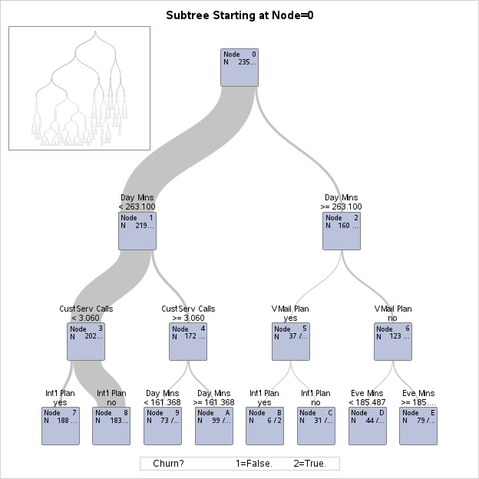
Best Model: DT with var selection
Variable Importance
Variable | Training |  | Validation |  | Relative Ratio | Count
 | Relative | Importance | Relative | Importance
Day Mins | 1.0000 | 12.1986 | 1.0000 | 6.6834 | 1.0000 | 19
CustServ Calls | 0.6053 | 7.3840 | 0.8099 | 5.4132 | 1.3381 | 1
Int'l Plan | 0.5104 | 6.2267 | 0.6831 | 4.5651 | 1.3382 | 3
Intl Mins | 0.5533 | 6.7499 | 0.6476 | 4.3279 | 1.1703 | 4
VMail Plan | 0.5023 | 6.1270 | 0.6144 | 4.1062 | 1.2232 | 5
Intl Calls | 0.4983 | 6.0790 | 0.5866 | 3.9204 | 1.1771 | 4
Eve Mins | 0.7429 | 9.0625 | 0.5737 | 3.8339 | 0.7722 | 15
Eve Calls | 0.2319 | 2.8291 | 0.2877 | 1.9228 | 1.2405 | 7
Night Mins | 0.4282 | 5.2237 | 0.2606 | 1.7418 | 0.6086 | 10
Account Length | 0.3354 | 4.0910 | 0.1579 | 1.0555 | 0.4709 | 14
Day Calls | 0.2417 | 2.9484 | 0.1111 | 0.7428 | 0.4598 | 5
VMail Message | 0.1335 | 1.6279 | 0.1020 | 0.6815 | 0.7641 | 3
Night Calls | 0.2077 | 2.5332 | 0.0603 | 0.4033 | 0.2906 | 4
Notes:
Presenter: E
This is the top part of DT & Variable importance chart.

Slide 23
Best Model: DT with var selection
(For Python Output of DT)
Notes:
Presenter: E

Slide 24
Explain Model – NB(SAS)
Factor 1: Day Mins (Num)
280 mins or more: the churn prob is 10.29 times higher than not churn prob
Factor 2: Customer Service Calls (Num)
4.8 (5) and above: the churn prob is 8.26 times higher than not churn prob
Factor 3: International Plan (Y/N)
Yes: the churn prob is 4.57 times higher than not churn prob

Slide 25
Conclusion and Recommendation
The most important predictors of customer churn are (both DT / NB model agree):
Day Mins: The number of minutes the customer used the service during daytime
CustServ Calls: The number of calls to customer support service
Int'l Plan: whether the customer has international calling plan
Notes:
Presenter: E

Slide 26
Conclusion and Recommendation
Recommendations to Company / BU:
Heavy users (having large Day Mins or Evening Mins + have Intl Plan) tends to have higher churn rates, we should pay more attention to improve customer experience
Especially: When they make more customer service calls
Flag system (CRM Department to work on?)
Notes:
Presenter: E

Slide 27
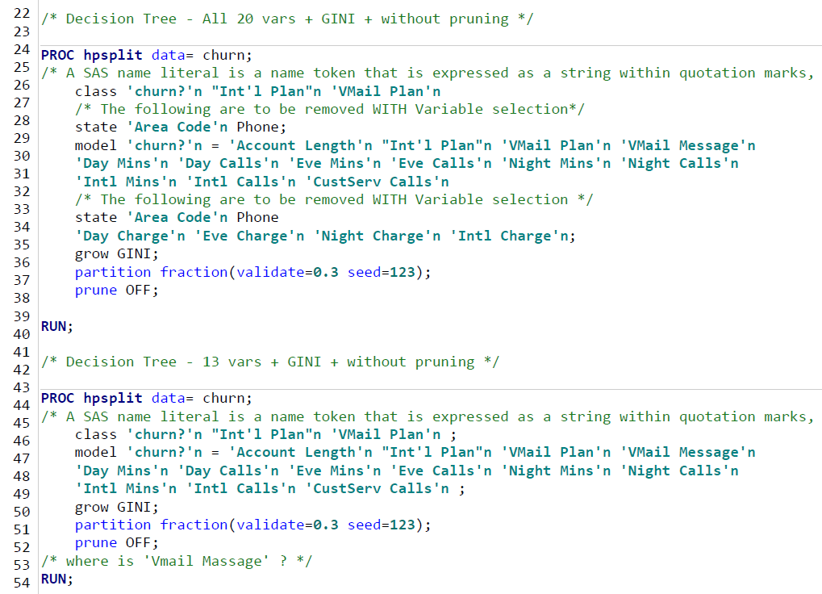
Backup Data DT Code

Slide 28
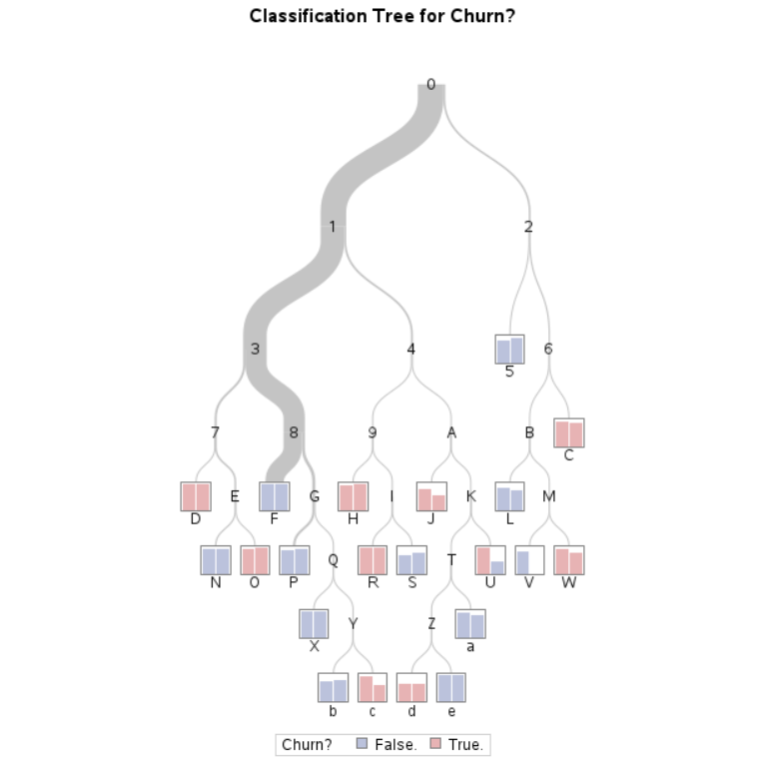
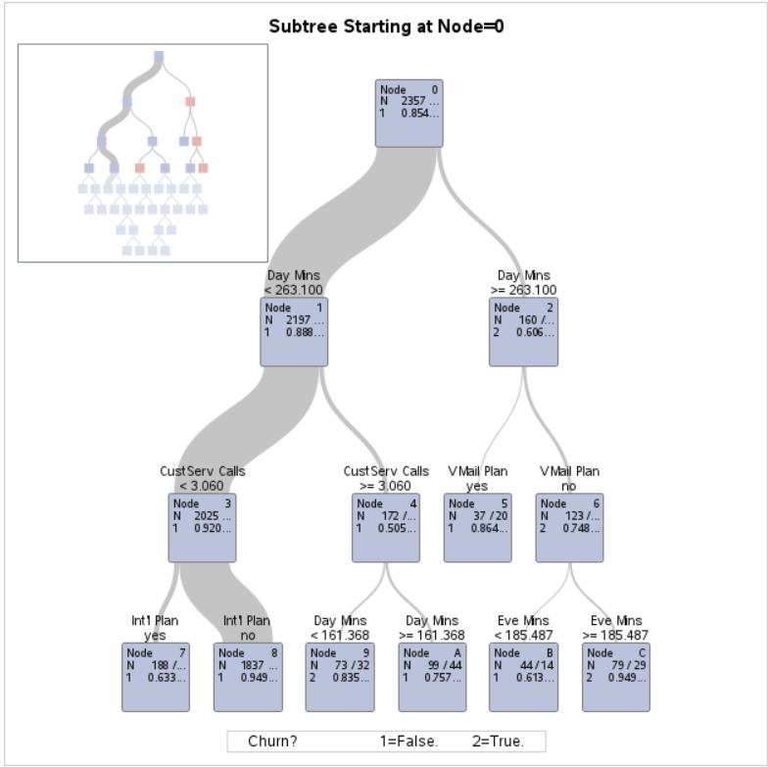
Backup Data With Pruning

Slide 29
Backup Data With Pruning
Variable Importance
Variable | Training |  | Validation |  | Relative Ratio | Count
 | Relative | Importance | Relative | Importance
Day Mins | 1.0000 | 11.2055 | 1.0000 | 6.3674 | 1.0000 | 6
CustServ Calls | 0.6590 | 7.3840 | 0.8501 | 5.4132 | 1.2901 | 1
Intl Mins | 0.5697 | 6.3836 | 0.6797 | 4.3279 | 1.1931 | 1
Int'l Plan | 0.5224 | 5.8535 | 0.6766 | 4.3082 | 1.2952 | 1
VMail Plan | 0.5115 | 5.7315 | 0.6268 | 3.9914 | 1.2255 | 2
Intl Calls | 0.5147 | 5.7672 | 0.6157 | 3.9204 | 1.1963 | 1
Eve Mins | 0.7113 | 7.9710 | 0.5952 | 3.7902 | 0.8368 | 6
Night Mins | 0.2712 | 3.0389 | 0.0737 | 0.4690 | 0.2716 | 1
Day Calls | 0.1885 | 2.1125 | 0.0000 | 0 | 0.0000 | 1

Slide 30
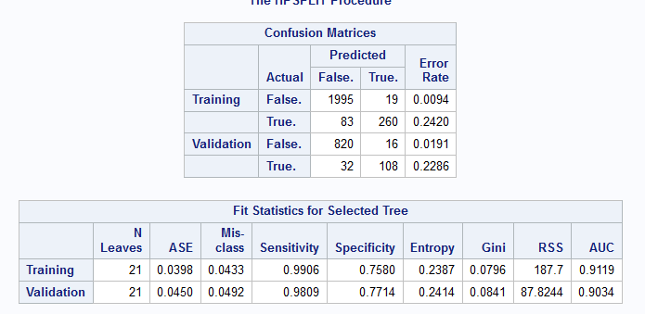
Backup Data With Pruning
Accuracy = 95.08%

Slide 31
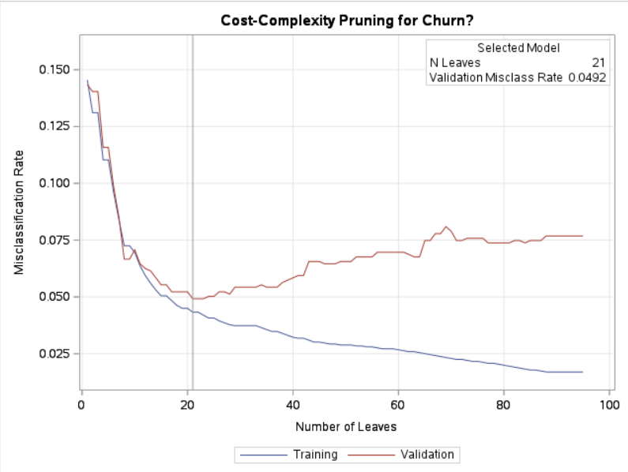
Backup Data Cost Complexity Chart

Slide 32
Backup Data NB Code
/* Naive Bayes - All Vars except Phone Number; without prescreening and variable selection */
/* There can be more than one input statement, one for NOMinal vars and the other for INTerval vars */
PROC hpbnet data= churn structure=Naive maxparents=1 prescreening= 0 varselect= 0;
target 'churn?'n;
input "Int'l Plan"n 'VMail Plan'n
/* The following are to be removed WITH Variable selection */
state 'Area Code'n ;
/* There can be more than one input statement, one for NOMinal vars and the other for INTerval vars */
input 'Account Length'n 'VMail Message'n
'Day Mins'n 'Day Calls'n 'Eve Mins'n 'Eve Calls'n 'Night Mins'n 'Night Calls'n
'Intl Mins'n 'Intl Calls'n 'CustServ Calls'n
/* The following are to be removed WITH Variable selection */
'Day Charge'n 'Eve Charge'n 'Night Charge'n 'Intl Charge'n/level=INT;
output network=network fit=fit PRED=prediction PARAMETER=parameter
VARSELECT=varselect VARINFO=varinfo VARLEVEL=varlevel;
partition fraction(validate=0.3 seed=123);
RUN;

Slide 33
Backup Data NB Code
proc print data=network noobs label;
RUN;
proc print data=fit noobs label;
RUN;
/*Prediction is not needed - comment out
proc print data=prediction noobs label;
RUN;
*/
proc print data=parameter noobs label;
RUN;
/* ONLY when bestmodel is present:
proc print data=validinfo noobs label;
var _bestmodel_ _miserrors_ _structure_ _prescreening_ _varselect_ _maxparents_;
RUN;
*/
proc print data=varselect noobs label;
RUN;
proc print data=varinfo noobs label;
RUN;
proc print data=varlevel noobs label;
RUN;

Slide 34
Backup Data NB Code
/*using data statement + freq statement + means procedure to show confusion matrix */
title 'calculate the confusion matrix of the NB model';
data NBconfusionmatrix;
set prediction;
predictedchurn='False.';
if 'P_Churn?True.'n > 'P_Churn?False.'n then predictedchurn='True.';
Match=0;
if 'churn?'n=predictedchurn then Match=1;
run;
proc freq data=NBconfusionmatrix;
table 'churn?'n * predictedchurn;
run;
title; /*delete the title*/
title 'calculate the accuracy of the NB model';
/*using Means procedure to calculate the accuracy of the NB model */
proc means data=NBconfusionmatrix mean;
var Match;
run;
title; /*delete the title*/

Slide 35
Backup Data NB - Config
Parameter Name | Parameter Value
ALPHA | 0.05
PRESCREENING | 0
VARSELECT | 0
STRUCTURE | NAIVE
PARENTING | BESTSET
MAXPARENTS | 1
MISSINGINT | IGNORE
MISSINGNOM | IGNORE
NBIN | 5
INDEPTEST | CHIGSQUARE

Slide 36
Backup Data
Variable Name | Selected | Chi-Square Statistics | G-Square Statistics | P-Value of Chi-Square Statistics | P-Value of G-Square Statistics | Mutual Information
Area Code | YES | 0.848 | 0.838 | 0.65426 | 0.65782 | 0.01883
Int'l Plan | YES | 170.442 | 127.991 | 0.00000 | 0.00000 | 0.22962
State | YES | 72.719 | 76.837 | 0.01960 | 0.00870 | 0.17887
VMail Plan | YES | 23.052 | 25.113 | 0.00000 | 0.00000 | 0.10282
Account Length | YES | 1.202 | 1.203 | 0.87781 | 0.87753 | 0.02256
CustServ Calls | YES | 239.212 | 169.821 | 0.00000 | 0.00000 | 0.26333
Day Calls | YES | 5.069 | 4.916 | 0.28032 | 0.29600 | 0.04559
Day Charge | YES | 197.447 | 150.681 | 0.00000 | 0.00000 | 0.24855
Day Mins | YES | 197.447 | 150.681 | 0.00000 | 0.00000 | 0.24855
Eve Calls | YES | 1.935 | 2.341 | 0.74773 | 0.67338 | 0.03147
Eve Charge | YES | 18.802 | 19.990 | 0.00086 | 0.00050 | 0.09178
Eve Mins | YES | 19.112 | 20.247 | 0.00075 | 0.00045 | 0.09237
Intl Calls | YES | 12.985 | 12.982 | 0.01135 | 0.01137 | 0.07402
Intl Charge | YES | 13.516 | 13.538 | 0.00901 | 0.00893 | 0.07558
Intl Mins | YES | 13.516 | 13.538 | 0.00901 | 0.00893 | 0.07558
Night Calls | YES | 8.857 | 8.608 | 0.06478 | 0.07169 | 0.06030
Night Charge | YES | 2.892 | 2.981 | 0.57599 | 0.56106 | 0.03551
Night Mins | YES | 2.794 | 2.890 | 0.59291 | 0.57632 | 0.03496
VMail Message | YES | 25.311 | 28.537 | 0.00004 | 0.00001 | 0.10956

Slide 37
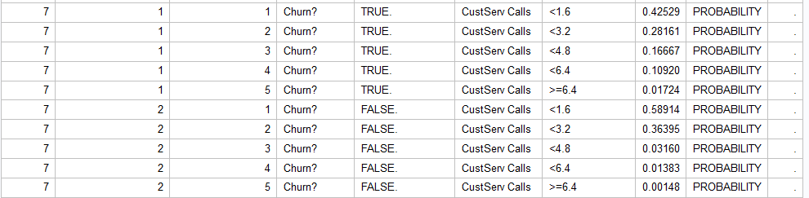
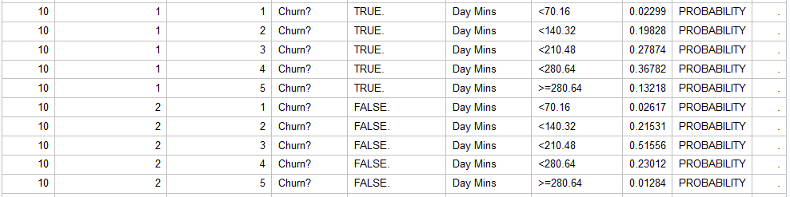
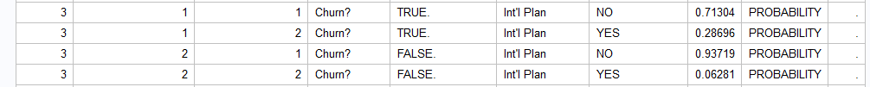
Backup Data

Slide 38
Abstract/Summary | 20
Clearly explain the aim of the project | 7.5
Explain the summary of the dataset (which dataset is chosen, how many rows, how many attributes) | 7.5
Which tools will be used and which ML methods will be used | 5
Data Preparation | 35
Look at the attribute type; e.g., nominal, ordinal, or quantitative (e.g., you could create a table with the attributes and the type) | 5
Any other selected three steps of data preparation (10 points per step) | 30
Predictive Modeling | 35
Classification using Decision Tree | 10
Classification using Naive Bayes | 10
Performance metrics for comparing the 2 techniques | 7.5
The baseline "all attributes" and "selected features" comparison | 7.5
Conclusions | 10
Major findings from different sections | 7.5
Recommendation to the company that they can put into place to solve their problem | 2.5
Bonus: Any additional data processing or analysis shown (please call it out explicitly in the document) | 5
Total Points | 105

